Slide 1
Hemodialysis Access in Unpleasant Patients
Kamyar MM,MD
Assistant professor of Vascular Surgery, Mashhad University of Medical Sciences

Slide 2
Unstable patients who needs urgent/emergent hemodialysis
This group includes patients present with hyperkalemia, pulmonary edema / dyspnea, severe nausea and vomiting, and other indications for urgent/emergent hemodialysis.
The best access is a previously created A-V shunt (AVF or AVG) which is planned several weeks ago for imminent hemodialysis.
If patient doesn’t have any hemodialysis access previously, an immediate access should be created for him/her.

Slide 3
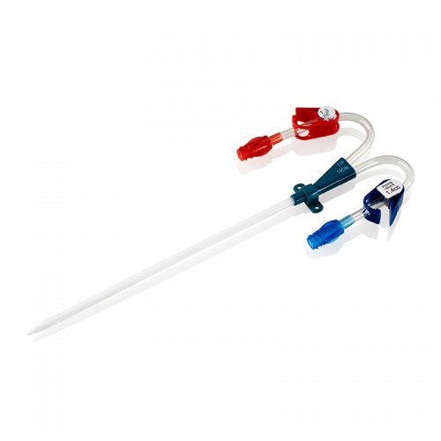
Double lumen catheters are the first choice access.

Slide 4
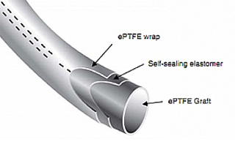
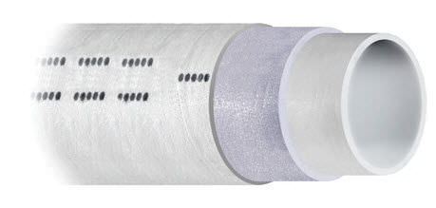
Rapid access AVG is a new access that could be used for patients who needs hemodialysis in future 24 hours. This graft is not used commonly yet.

Slide 5
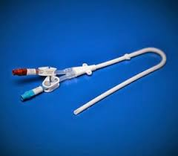
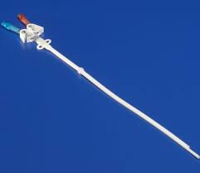
Patient with Short Life Expectancy
Very old or very sick patients or patients with comorbidities (who are not expected to live more than next several months) can profit from tunneled catheter.

Slide 6
Hypotensive patients
In patients with low systolic blood pressure A-V shunts will not function and tunneled catheter is recommended for them.
Some experts advise thigh AVG for this group.

Slide 7
No Access patients

