Slide 2
URGENT HD INDICATION
Dr.Sabbagh
24.6.98

Slide 3
DEFINITION:
Acute renal failure (ARF) is an abrupt and usually reversible decline in the glomerular filtration rate (GFR).
This results in an elevation of serum blood urea nitrogen (BUN), creatinine, and other metabolic waste products that are normally excreted by the kidney.
The term acute kidney injury (AKI) rather than ARF is increasingly used by the nephrology community to refer to the acute loss of kidney function.
This term also highlights that injury to kidney that does not results in “failure” is also of great clinical significance.
Among critically ill patients admitted to intensive care units (ICUs), the incidence of AKI is as high as 50% and is associated with dismal outcomes.
Notes:
Acute renal failure (ARF) is an abrupt and usually reversible decline in the glomerular filtration rate (GFR). This results in an elevation of serum blood urea nitrogen (BUN), creatinine, and other metabolic waste products that are normally excreted by the kidney.
The term acute kidney injury (AKI) rather than ARF is increasingly used by the nephrology community to refer to the acute loss of kidney function. This term also highlights that injury to kidney that does not results in “failure” is also of great clinical significance. In this topic review, the acute loss of kidney function will be referred to as AKI.

Slide 5
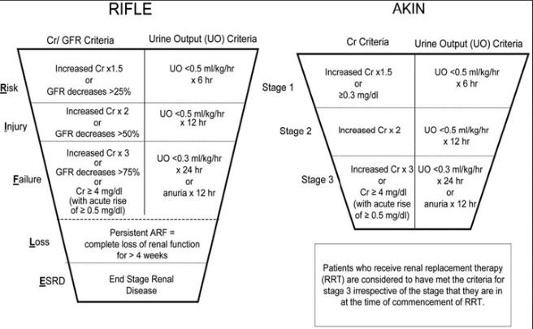

Slide 6
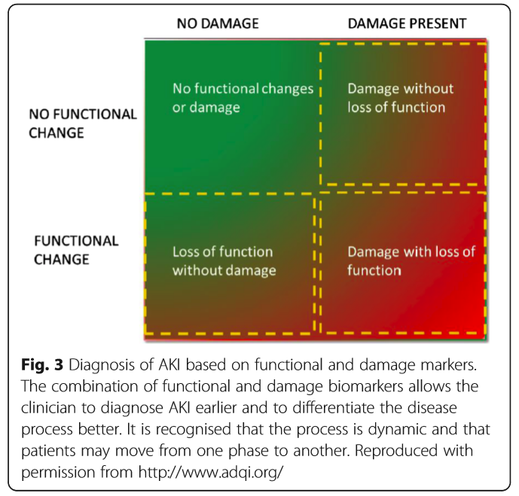

Slide 7
AKI can range in severity from :
asymptomatic and transient changes in laboratory parameters of glomerular filtration rate (GFR),
to overwhelming and rapidly fatal derangements in effective circulating volume regulation and electrolyte and acid-base composition of the plasma.
AKI
Asymptomatic Rapidly Fatal Derangement

Slide 8
Acute kidney injury (AKI), previously known as acute renal failure
AKI is not a single disease but, rather, a designation for a heterogeneous group of conditions that share common diagnostic features:
an increase in BUN
and/or an increase in SCr
often associated with a reduction in urine volume.
AKI is a clinical diagnosis and not a structural one
(A patient may have AKI without injury to the kidney parenchyma)
Notes:
Acute kidney injury (AKI), previously known as acute renal failure, is
characterized by the sudden impairment of kidney function resulting in
the retention of nitrogenous and other waste products normally cleared by
the kidneys. AKI is not a single disease but, rather, a designation for a heterogeneous
group of conditions that share common diagnostic features:
specifically, an increase in the blood urea nitrogen (BUN) concentration
and/or an increase in the plasma or serum creatinine (SCr) concentration,
often associated with a reduction in urine volume. It is important
to recognize that AKI is a clinical diagnosis and not a structural one. A
patient may have AKI without injury to the kidney parenchyma. AKI can
range in severity from asymptomatic and transient changes in laboratory
parameters of glomerular filtration rate (GFR), to overwhelming and
rapidly fatal derangements in effective circulating volume regulation and
electrolyte and acid-base composition of the plasma

Slide 9
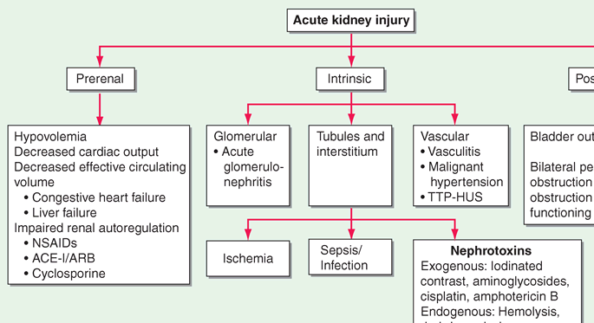

Slide 10
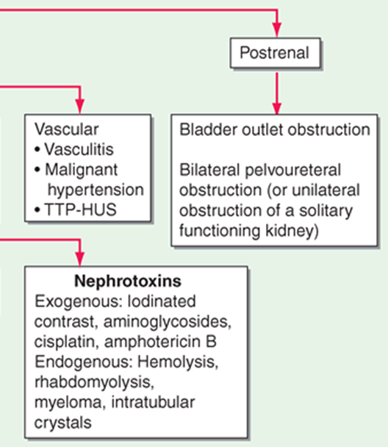

Slide 11
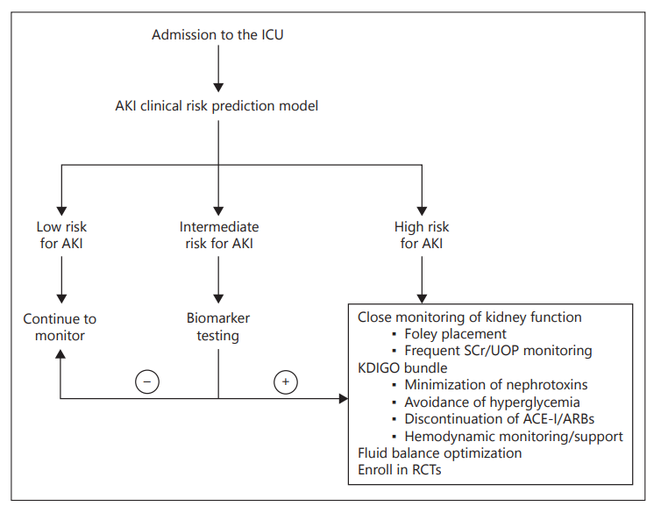

Slide 12
Management
Principally supportive
Renal replacement therapy (RRT) indicated in patients with severe kidney injury.
Multiple modalities of RRT are currently available.
intermittent hemodialysis (IHD),
continuous renal replacement therapies (CRRTs),
hybrid therapies, such as sustained low-efficiency dialysis (SLED).
Mortality in patients with ARF remains high, greater than 50 percent in severely ill patients.

Slide 13
The initiation of RRT in patients with AKI prevents uremia and immediate death from the adverse complications of renal failure.

Slide 14
INDICATIONS FOR AND TIMING OF INITIATION OF DIALYSIS
Accepted indications for renal replacement therapy (RRT) in patients with AKI generally include:
Refractory fluid overload
Hyperkalemia (plasma potassium concentration >6.5 meq/L) or rapidly rising potassium levels
Signs of uremia, such as pericarditis, neuropathy, or an otherwise unexplained decline in mental status
Metabolic acidosis (pH less than 7.1)
Certain alcohol and drug intoxications

Slide 16
Volume overload
Several observational studies have demonstrated an association between the severity of volume overload at the time of initiation of RRT and mortality risk
Fluid overload may contribute to organ dysfunction and contribute to mortality risk, observational studies cannot establish a causal link between the severity of volume overload and outcomes.
Underlying diseases states that drive the use of more aggressive volume resuscitation may account for the increased mortality risk.

Slide 17
Non-emergent dialysis may also be indicated for patients with prolonged AKI even in the absence of the indications listed above.
The optimal time to start dialysis is not known and the BUN is only one of multiple parameters that may be used to assess dialysis requirement

Slide 18
Patients with any of these complications despite appropriate medical therapy generally require urgent dialysis.
However, since hemodialysis often cannot be immediately provided, such patients usually require medical treatment during the period prior to the initiation of hemodialysis.

Slide 19
Timing
Whether initiation of earlier or prophylactic dialysis offers any clinical or survival benefit is unproven.
We suggest initiating dialysis prior to the development of symptoms and signs of renal failure due to AKI.

Slide 20
THE HEMODIALYSIS PRESCRIPTION

Slide 21
OPTIMAL MODALITY
Intermittent hemodialysis (IHD)
Peritoneal dialysis
Continuous renal replacement therapy (CRRT)
Hybrid therapies such as SLED

Slide 22
Acute hemodialysis in a 70-kg adult:
Rx: Acute hemodialysis (not for initial treatment)
Session length: Perform hemodialysis for 4 hours
Blood flow rate: 350 mL/min
Dialyzer:
Dialyzer membrane: your choice
Dialyzer KUF: your choice
Dialyzer efficiency: usually a dialyzer with a K0A of 800–1200

Slide 23
-CRRT:
Represents a family of modalities that provide continuous support for severely ill patients with AKI.
These include:
continuous hemofiltration
hemodialysis
hemodiafiltration
which involve both convective and diffusive therapies.
Although superior clearance of middle and larger molecular weight molecules are associated with convective therapies (hemofiltration) compared with diffusive therapies (hemodialysis), there are no studies clearly showing improved clinical outcomes compared with the type of solute transport.
Current data suggest that survival and recovery of renal function are similar with both CRRT and IHD.
Notes:
Represents a family of modalities that provide continuous support for severely ill patients with AKI.
These include:
continuous hemofiltration,
hemodialysis,
hemodiafiltration,
which involve both convective and diffusive therapies.
Although superior clearance of middle and larger molecular weight molecules are associated with convective therapies (hemofiltration) compared with diffusive therapies (hemodialysis), there are no studies clearly showing improved clinical outcomes compared with the type of solute transport.
Current data suggest that survival and recovery of renal function are similar with both CRRT and IHD.
CRRT Versus IHD : no survival benefit can be attributed to either modality

Slide 24
Data do not support the superiority of any particular mode of RRT in patients with AKI.
In the majority of patients, selection of modality should therefore be based upon :
local expertise
availability of staff
equipment.
In acute brain injury or fulminant hepatic failure, continuous therapy may be associated with better preservation of cerebral perfusion.

Slide 25
Discontinuation of RRT:
The decision to discontinue RRT in patients with AKI is made based on 1 of 3 clinical scenarios:
intrinsic kidney function has adequately improved to meet demands,
the disorder that prompted renal support has improved,
or continued RRT is no longer consistent with goals of care.
There is no definitive prospective evidence to guide clinicians, but urine output appears to be predictive of successful RRT discontinuation.
In one study of patients on CRRT, 24-hour urine output > 400 mL/d in patients not using diuretics or >2,300 mL/d in patients using diuretics had >80% chance of successful RRT discontinuation.
Other studies have suggested that quantitation of timed urinary creatinine and urea excretion (either as total excretion per 24-hour period or calculation of creatinine and urea clearance) may be helpful.
Prospective studies are needed to help guide clinicians on when to attempt RRT discontinuation.

Slide 26
CRRT: Current guidelines recommend goal effluent flow rates of 20 to 25 mL/kg/h.
IHD dosing: it is important to routinely check the urea reduction ratio or Kt/V to ensure that dialysis is adequate.
In the VA/NIH ATN study:
median duration of an IHD session was 4 hours,
with a mean blood flow rate of 360 mL/min,
highlighting that in these catabolic patients, substantial time is needed to ensure an adequate dialysis dose.
Notes:
current guidelines recommend goal effluent
flow rates of 20 to 25 mL/kg/h.
With regard to IHD dosing, it is important to routinely
check the urea reduction ratio or Kt/V to ensure that
dialysis is adequate. In the VA/NIH ATN study, median
duration of an IHD session was 4 hours, with a mean
blood flow rate of 360 mL/min, highlighting that in these
catabolic patients, substantial time is needed to ensure an
adequate dialysis dose. Discontinuation of RRT
The decision to discontinue RRT in patients with AKI is
made based on 1 of 3 clinical scenarios: intrinsic kidney
function has adequately improved to meet demands, the
disorder that prompted renal support has improved, or
continued RRT is no longer consistent with goals of care.
There is no definitive prospective evidence to guide clinicians, but urine output appears to be predictive ofsuccessful RRT discontinuation. In one study of patients on
CRRT, 24-hour urine output > 400 mL/d in patients not
using diuretics or >2,300 mL/d in patients using diuretics
had >80% chance of successful RRT discontinuation. Other
studies have suggested that quantitation of timed urinary
creatinine and urea excretion (either as total excretion per
24-hour period or calculation of creatinine and urea
clearance) may be helpful. Prospective studies are needed
to help guide clinicians on when to attempt RRT
discontinuation.

Slide 27
The 2012 KDIGO guidelines for AKI recommend:
IHD: Delivering a Kt/V of 3.9 per week for patients undergoing intermittent therapy
CRRT:recommend delivering an effluent volume of 20 to 25 mL/kg/h, but which notes that this generally requires prescription of a higher effluent volume to achieve the targeted dose of therapy
Notes:
The 2012 KDIGO guidelines for AKI recommend delivering a Kt/V of 3.9 per week for patients undergoing intermittent therapy
Continuous renal replacement therapy — For patients on CRRT, we generally aim to provide a delivered effluent flow rate (sum of hemofiltration rate and dialysate flow rate) of at least 20 mL/kg per hour. In order to ensure delivery of this flow rate, we prescribe an effluent flow rate of at least 25 mL/kg per hour. This is consistent with the 2012 KDIGO guidelines that recommend delivering an effluent volume of 20 to 25 mL/kg/h, but which notes that this generally requires prescription of a higher effluent volume to achieve the targeted dose of therapy

Slide 28
Dialysis frequency and dose for subsequent treatments and dialysis adequacy.
It is difficult to deliver a large amount of dialysis in the acute setting.
Most intensive care unit patients are fluid overloaded, and urea distribution volume is often much greater than 50%–60% of body weight.
True delivered blood flow rate through a venous catheter rarely exceeds 350 mL/ min and is often substantially lower.
Recirculation occurs in venous catheters and is greatest with catheters in the femoral position owing to the low pericatheter venous flow rate.
Often, the treatment is interrupted owing to hypotension.
The degree of urea sequestration in muscle may be increased, as such patients are often on pressors, reducing blood flow to muscle and skin, which contain a substantial portion of urea and other dissolved waste products.
Concomitant intravenous infusions, which are often given to patients in an acute setting, dilute the urea level in the blood and reduce further the efficiency of dialysis.

Slide 29
A typical 3- to 4-hour acute-dialysis session will deliver a single-pool Kt/V of only 0.9, with an equilibrated Kt/V of 0.7.
Dialysate-side urea removal may be even lower (Evanson, 1999).
This low level of Kt/V, if given three times per week, is associated with a high mortality in chronic, stable patients.
One option is to dialyze sick patients with acute renal failure on a daily (six or seven times per week) basis.
Each treatment is then approximately 3–4 hours in length.
Data by Schiffl (2002) suggest that mortality is reduced in patients with acute renal failure dialyzed six times per week as opposed to those receiving dialysis every other day.
If every-other-day dialysis is to be given, the treatment length should probably be set at 4–6 hours, to deliver a single pool Kt /V of at least 1.2–1.3, as recommended for chronic therapy.

Slide 30
Acute patients dialyzed either 3 or 6 times per week and found absolutely no difference in outcomes.
KDIGO workgroup on acute kidney injury (2012) recommends that when attempting to maintain acute patients on a 3-times-per-week schedule, each treatment should have a Kt/V of ≥1.3.
Notes:
The VA/NIH (2008) study compared outcomes in acute patients dialyzed either 3 or 6 times per week and found absolutely no difference in outcomes.
The intensity of dialysis in the 3-times-per-week group was substantially higher (Kt/V of 1.3 or more) than in the Schiffl article.
For this reason, the KDIGO workgroup on acute kidney injury (2012) recommends that when attempting to maintain acute patients on a 3-times-per-week schedule, each treatment should have a Kt/V of ≥1.3.
When there is a concern that there is inconsistent dialysis delivery (e.g., catheter flow or hollow-fiber thrombosis problems), one can verify HD adequacy by assessing the URR using blood tests or devices that measure real-time solute clearance (ionic conductance or UV-absorption technologies).

